Slide 1

DOCTOR APPOINTMENT SYSTEM
GROUP MEMBERS
Stelin Maria C J
Amrutha Ajay
Linu Charly
GUIDE IN CHARGE
Dijesh p

Slide 2
OUTLINE
INTRODUCTION
EXISTING SYSTEM
PROPOSED SYSTEM
MODULE DESCRIPTION
DATAFLOW DIAGRAM
ER DIAGRAM
SCREENSHOTS
CONCLUSION

Slide 3
INTRODUCTION
The Doctor appointment system contains an admin and user sides.
The admin side add and manages doctors’ records, patient records , feedback section and so on.
For the user section, the users can either be a patient or a doctor.
The doctor can log in as a doctor, check their appointment, view patient details etc.
The patient can book and cancel appointments,search for doctors and add feedback.

Slide 4
Existing System
In the existing system the patient needs to visit the doctor for booking we need to wait and the booking will be done manually so to maintain everything is always a problem.
Proposed System
In the proposed system the doctors and patients are brought to one platform will allow patients to be more flexible.
They can register and search for the doctors basing on the location the list of doctors will be shown and patient can book by selecting the time .

Slide 5
MODULE DESCRIPTION
Doctor appointment system includes the following modules
➢Admin
➢Doctor
➢Patient
ADMIN
Admin can add and delete doctors. Admin can view list of doctors and Patients and view feedbacks.
DOCTOR
Doctors can view their information, appointments, patient list. .
PATIENT
Patients can view their information, can book and cancel appointments by selecting doctor.

Slide 6
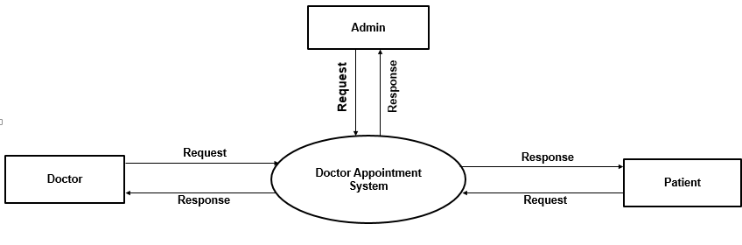
DATA FLOW DIAGRAM
DFD Level 0

Slide 7
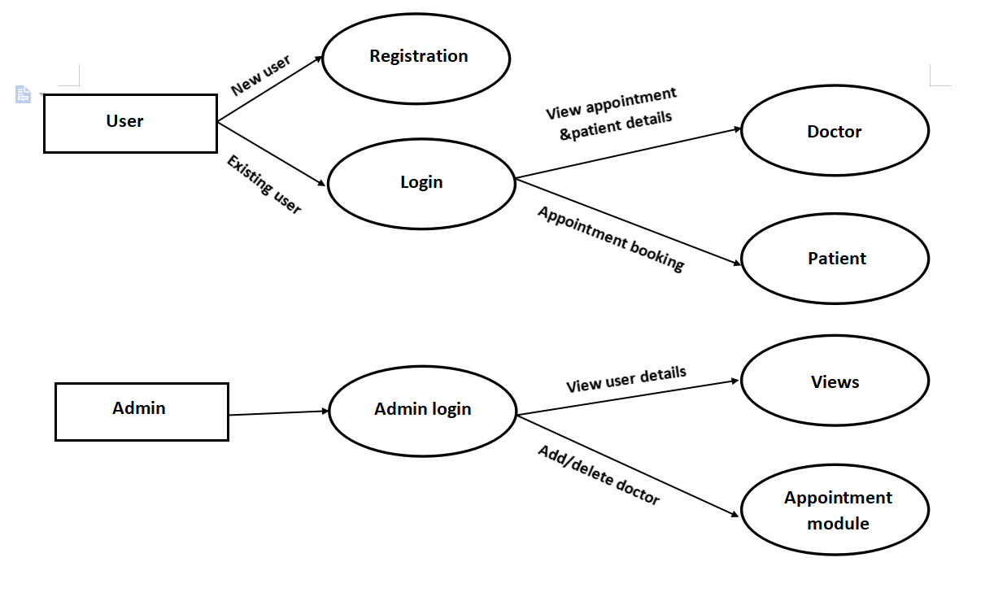
DFD Level1

Slide 8
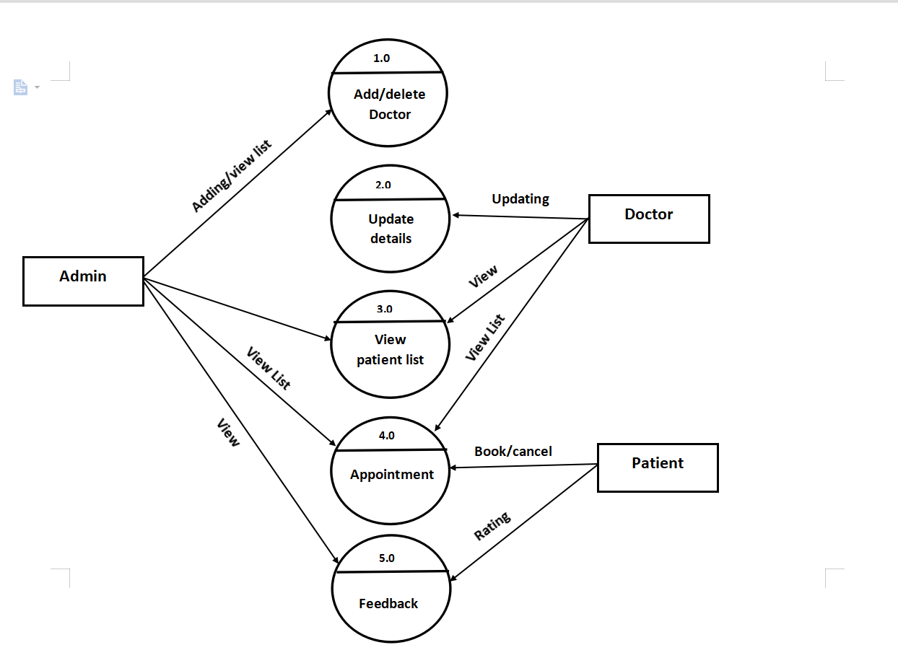
DFD Level2

Slide 9
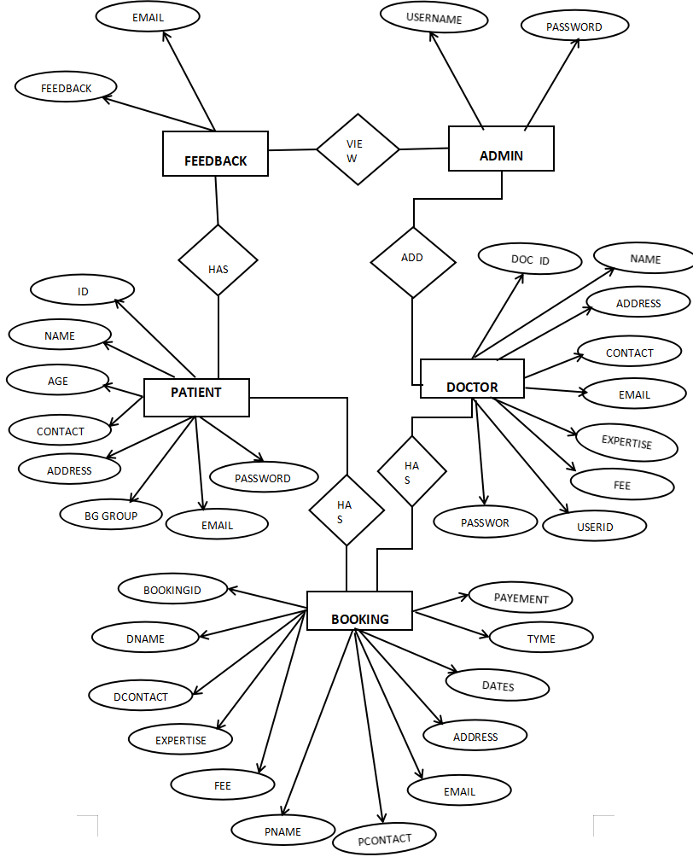
ER- DIAGRAM

Slide 10
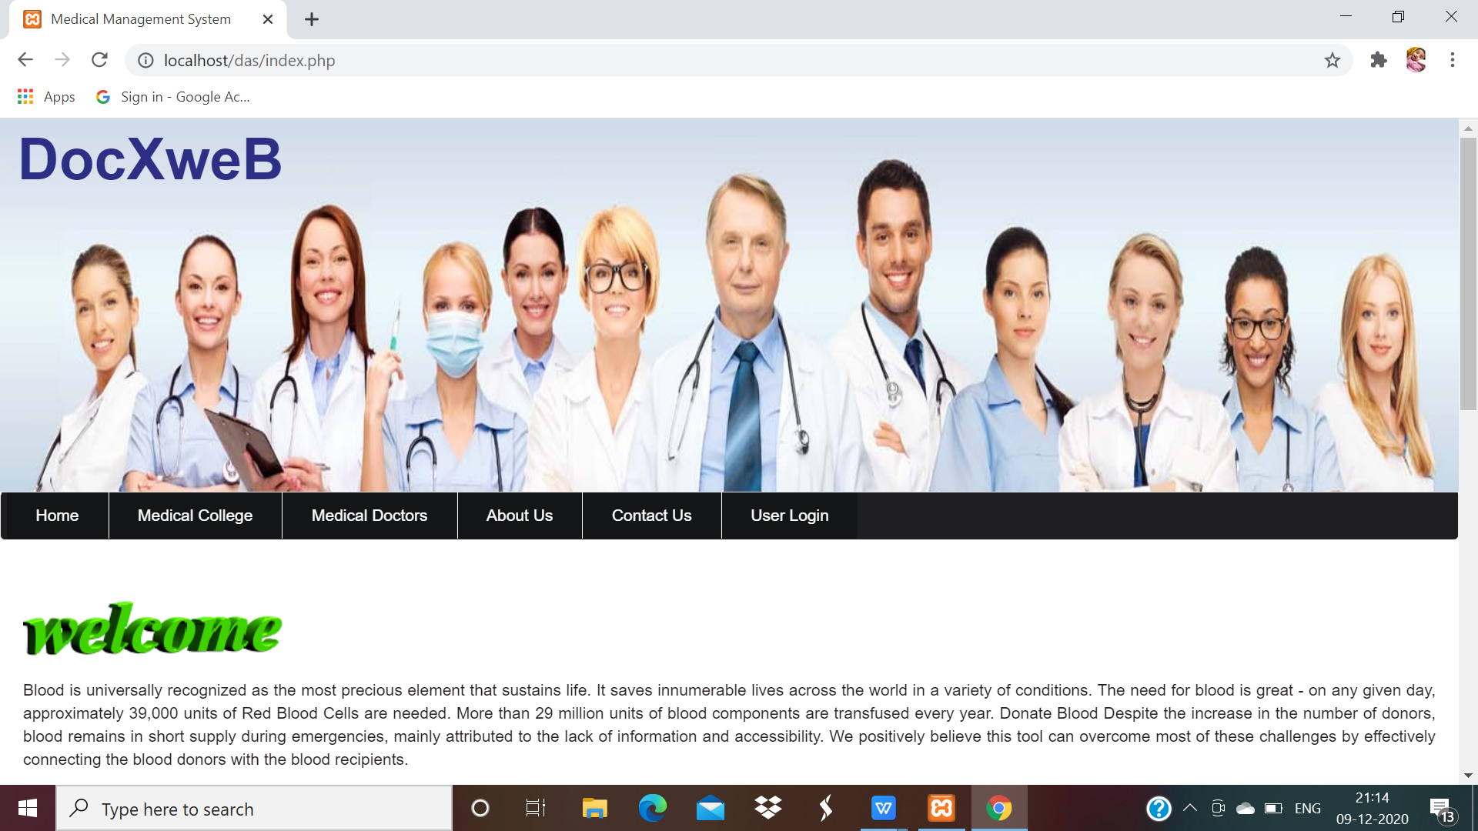
SCREENSHOTS

Slide 11
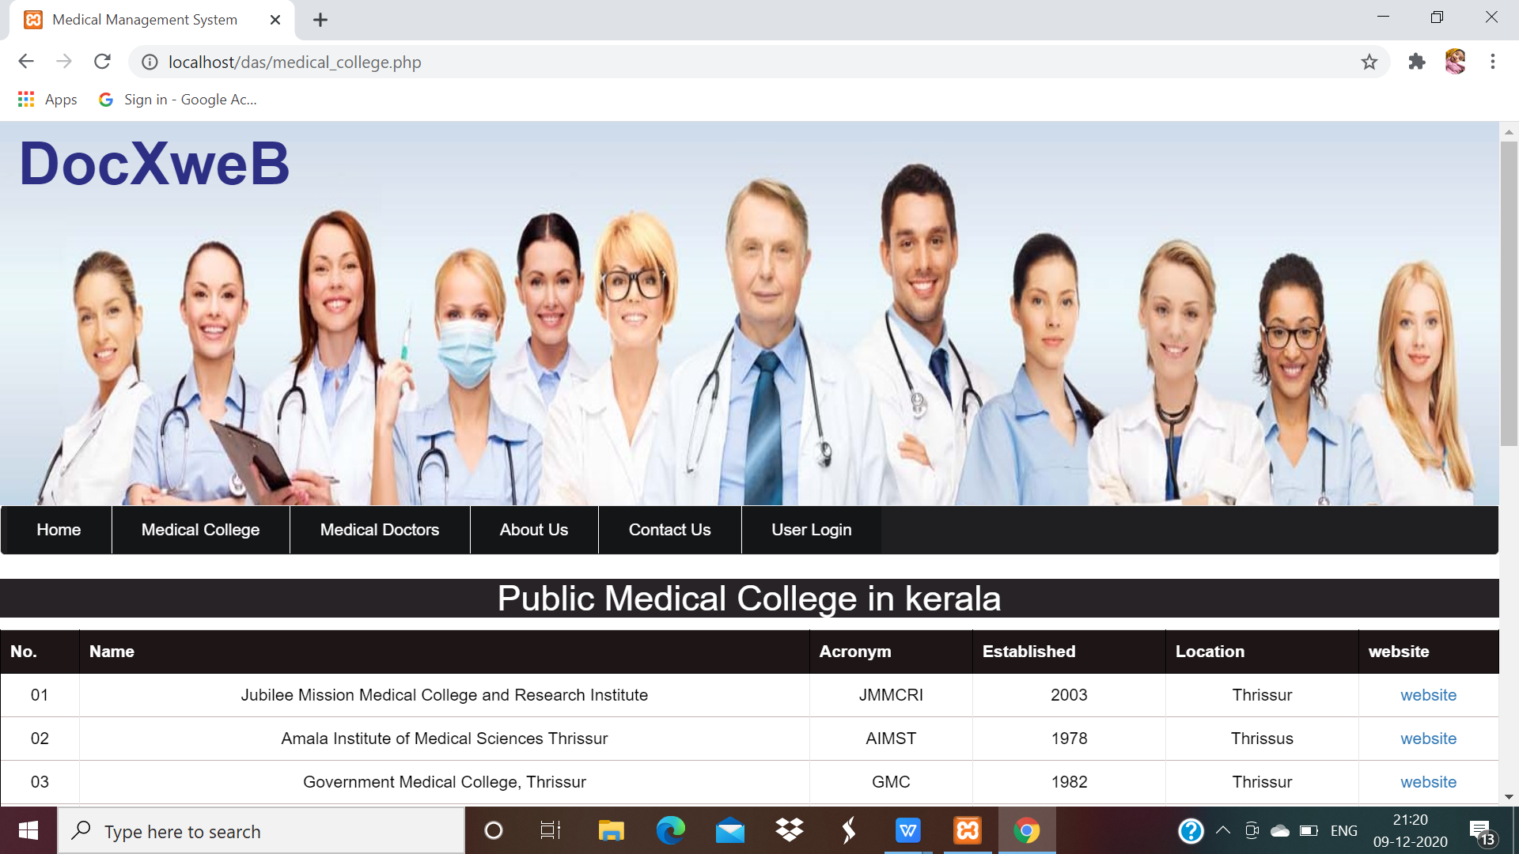

Slide 12
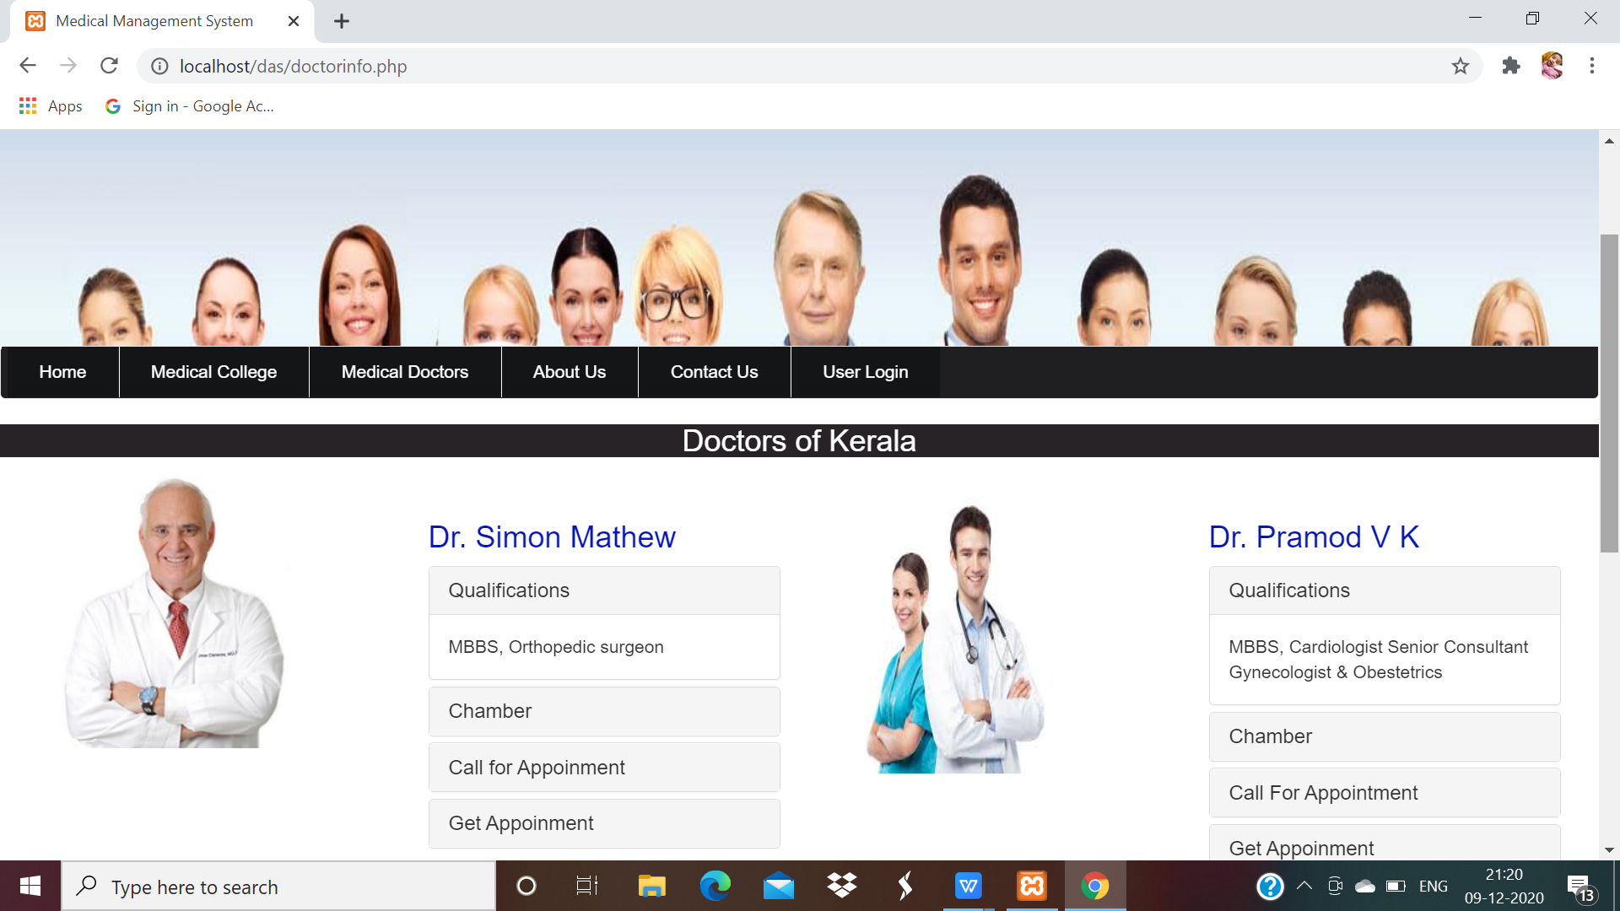

Slide 13
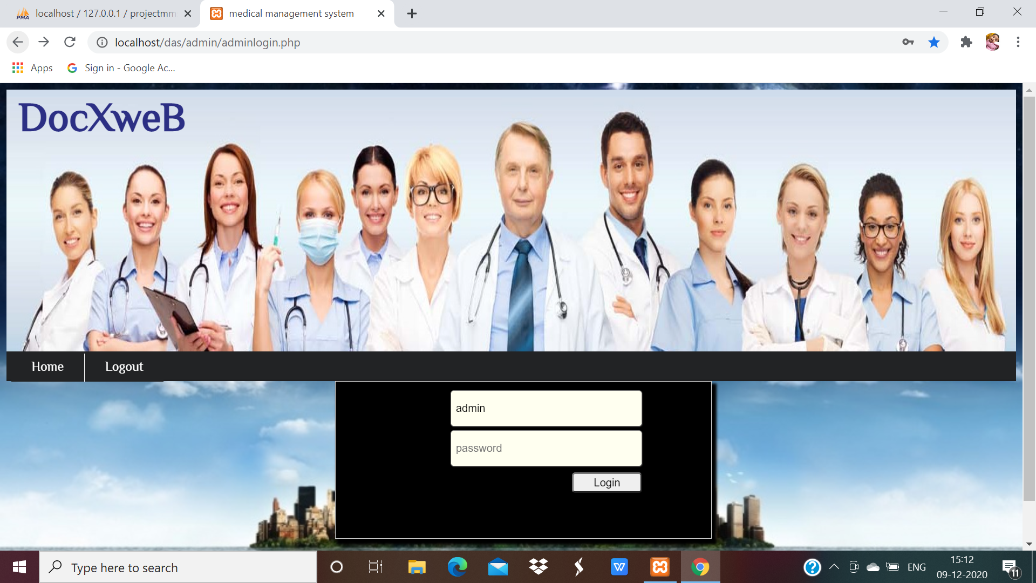
ADMIN

Slide 14
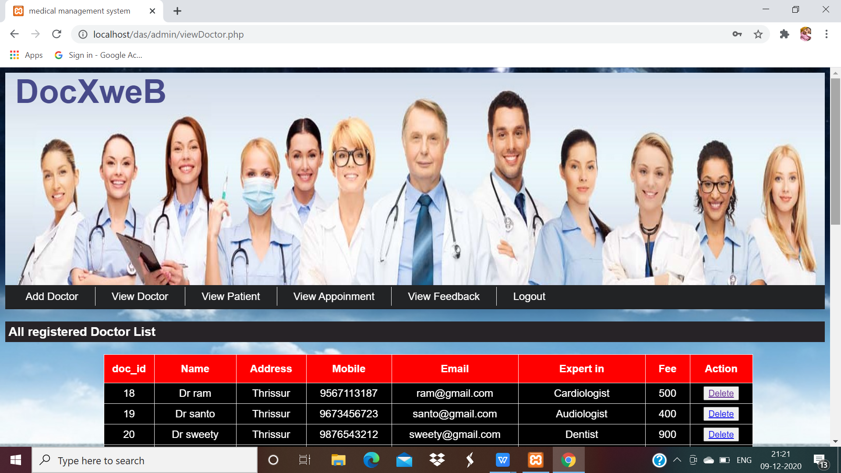

Slide 15
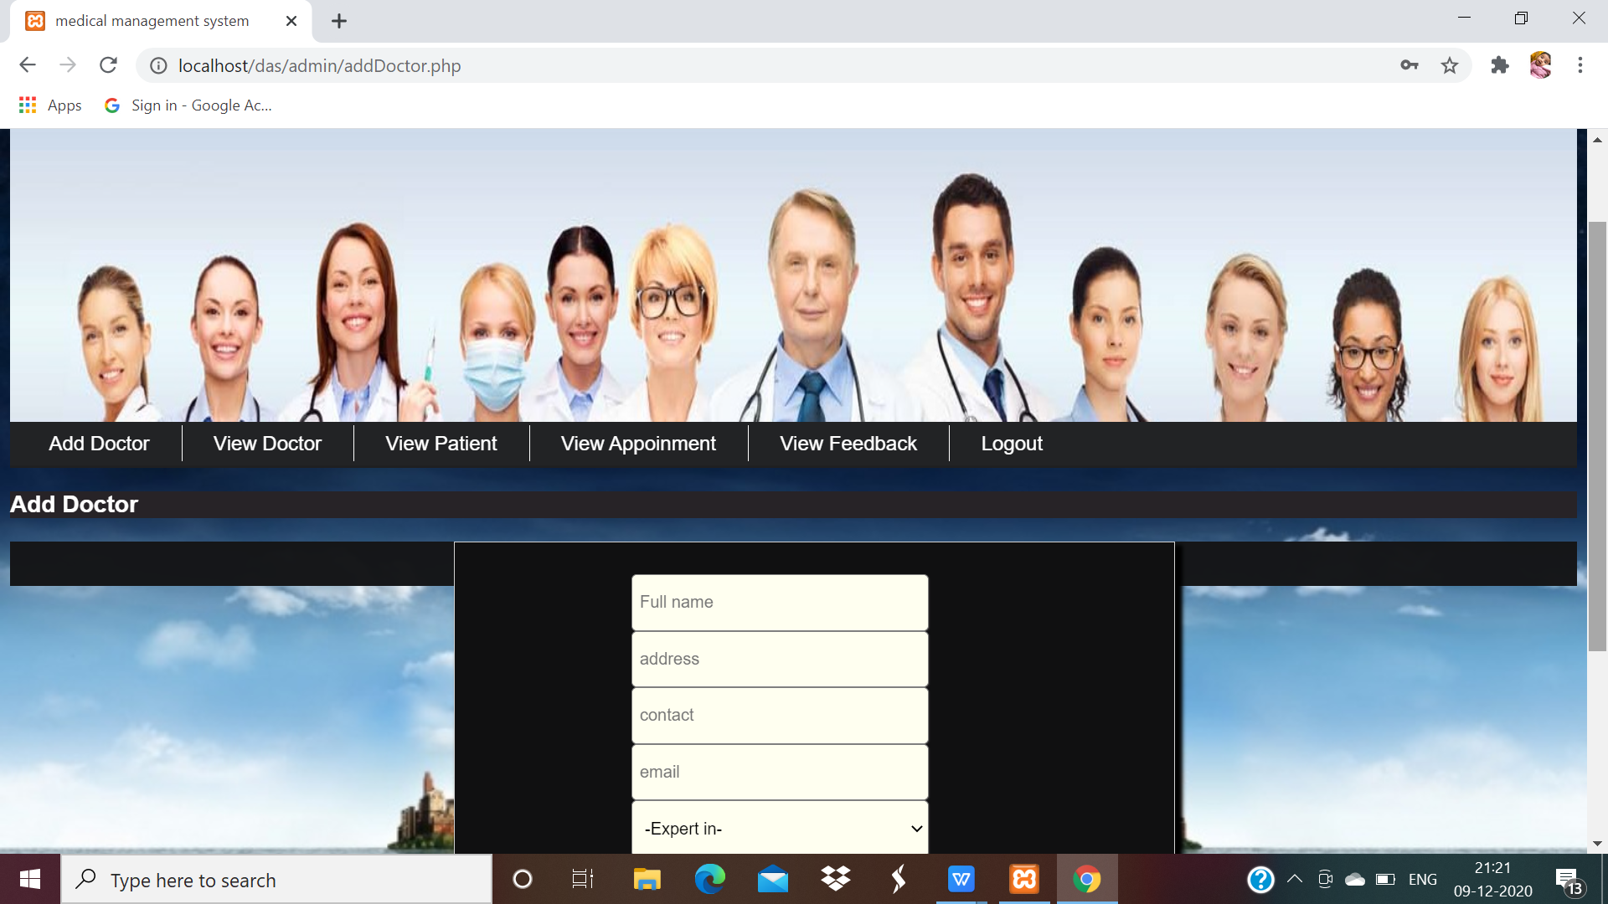

Slide 16
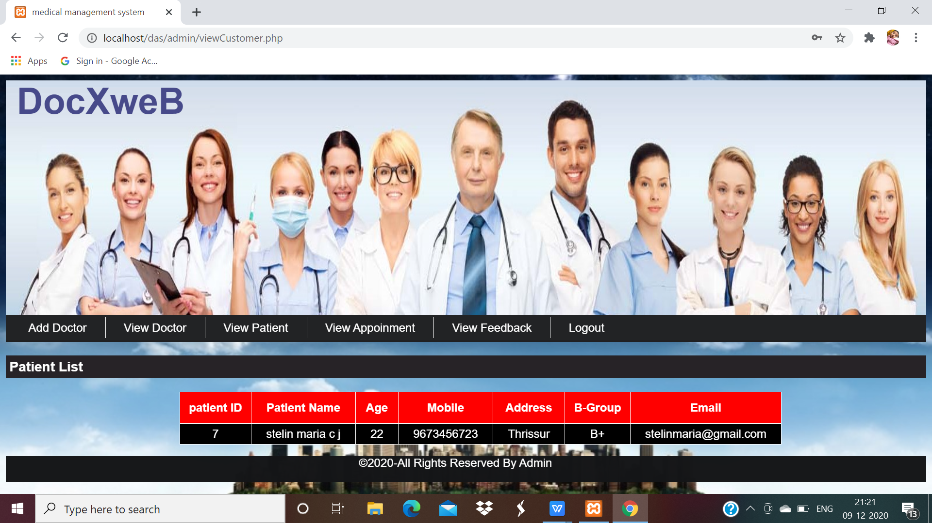

Slide 17
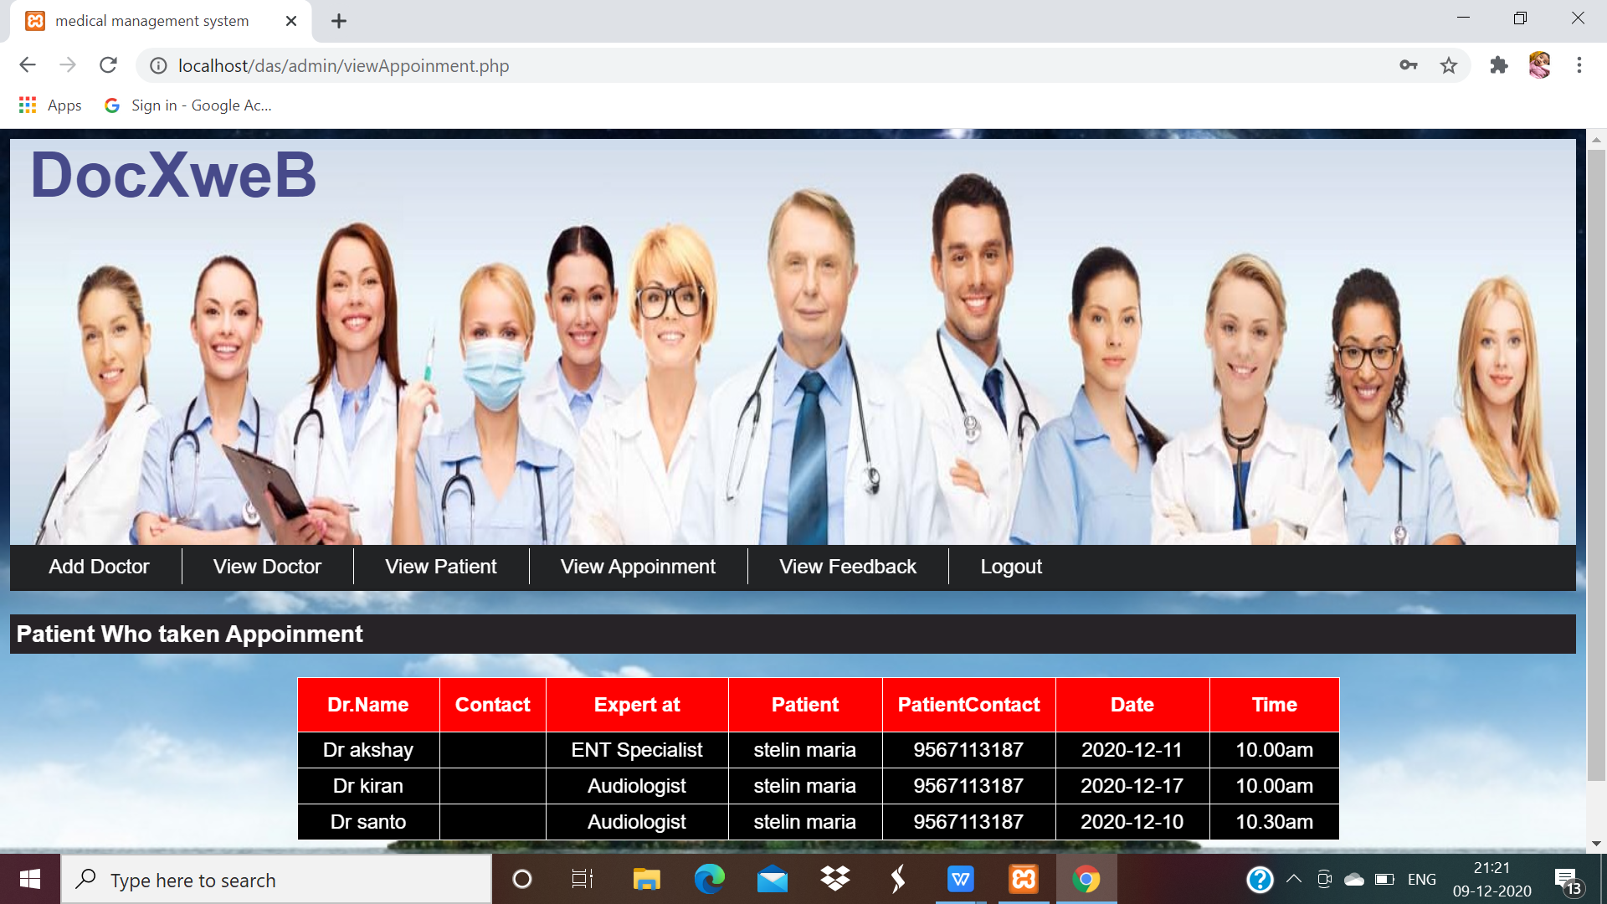

Slide 18
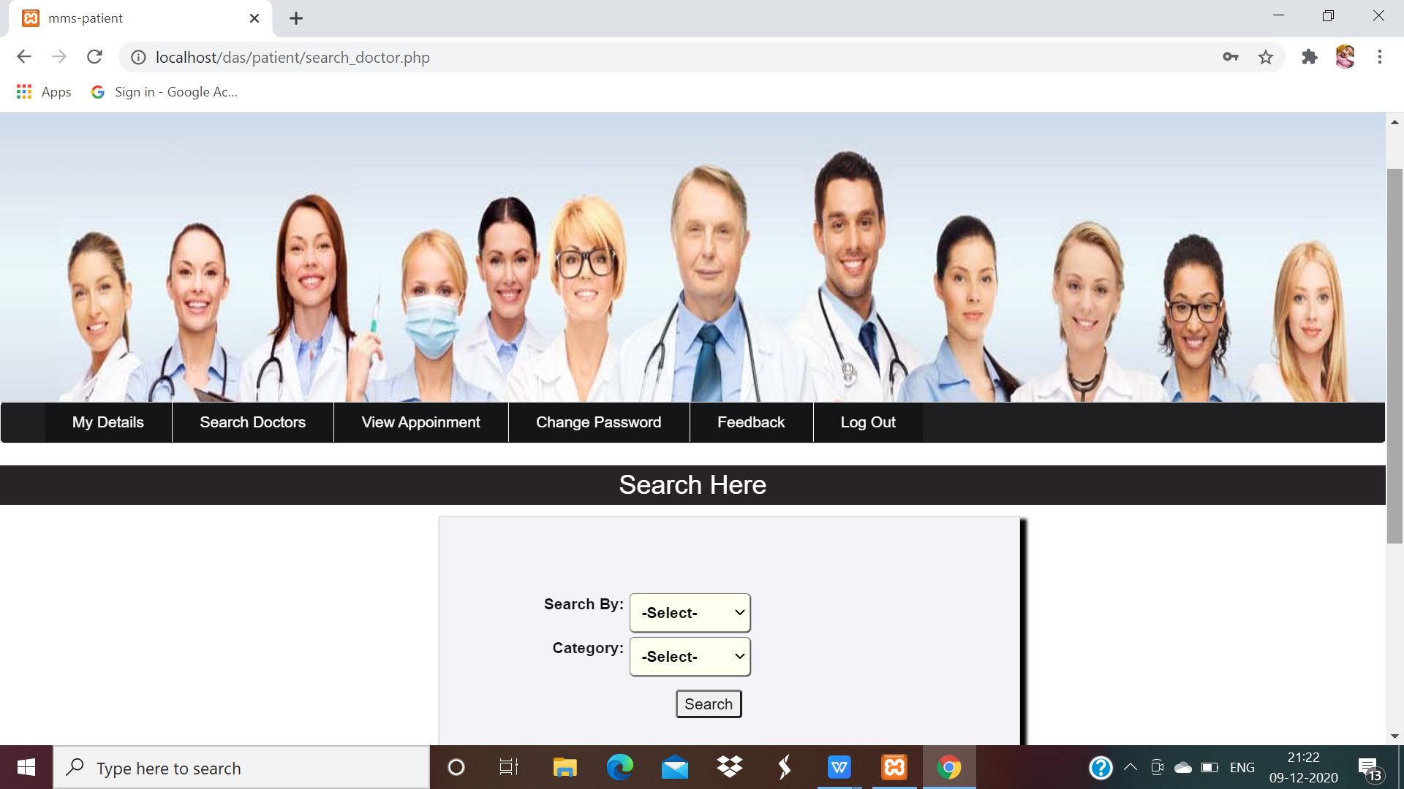
PATIENT

Slide 19
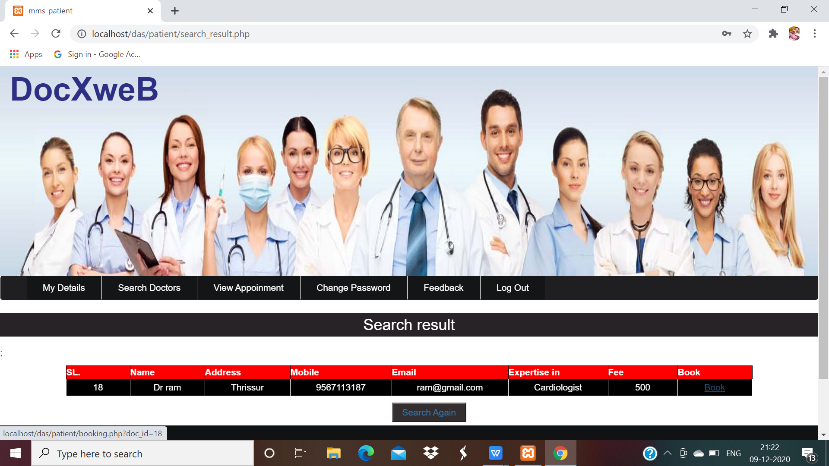

Slide 20
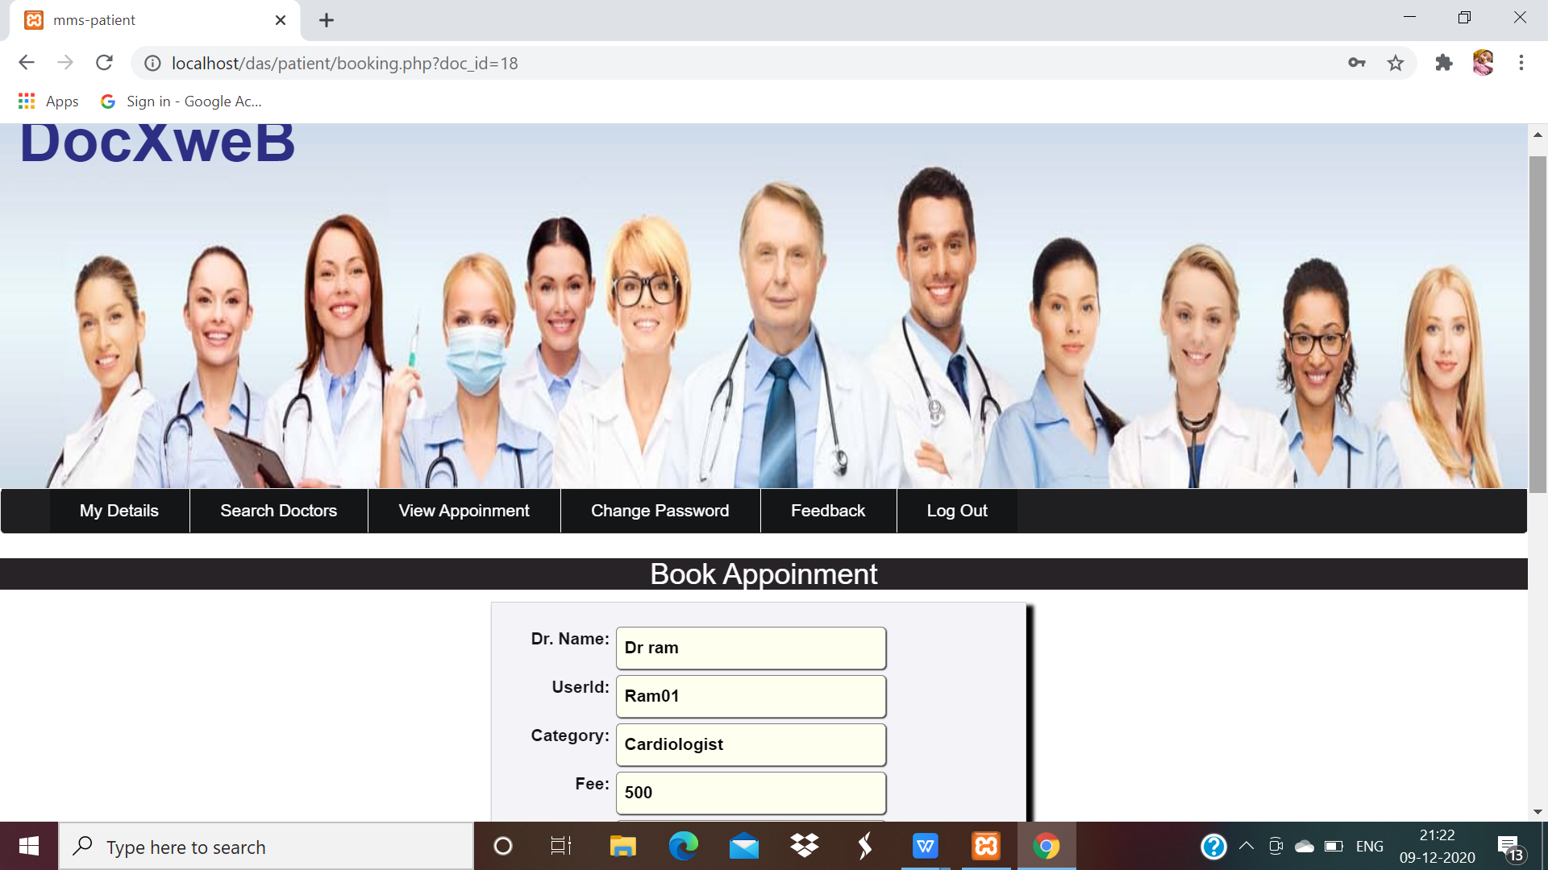

Slide 21
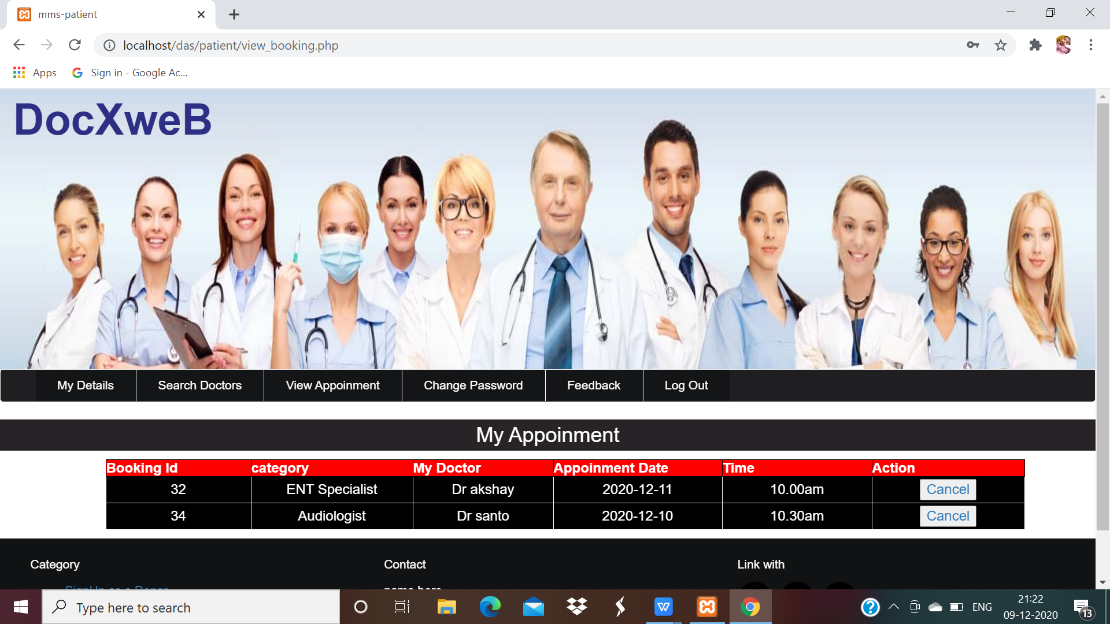

Slide 22
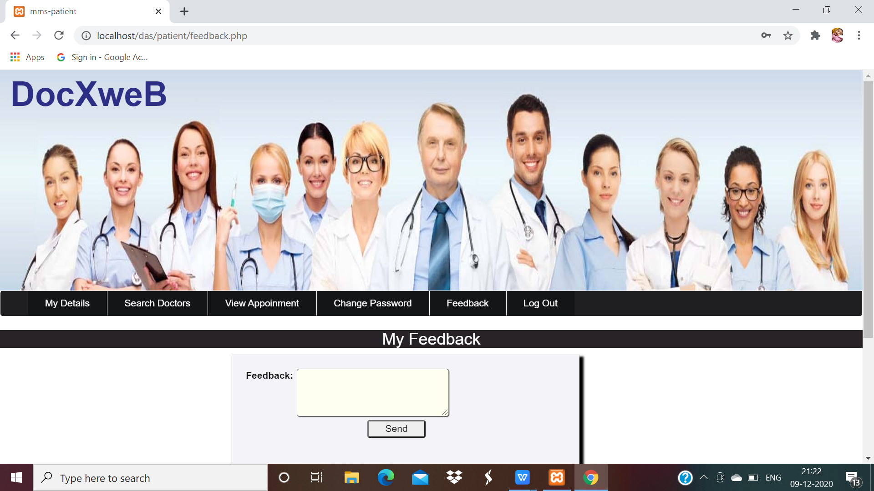

Slide 23
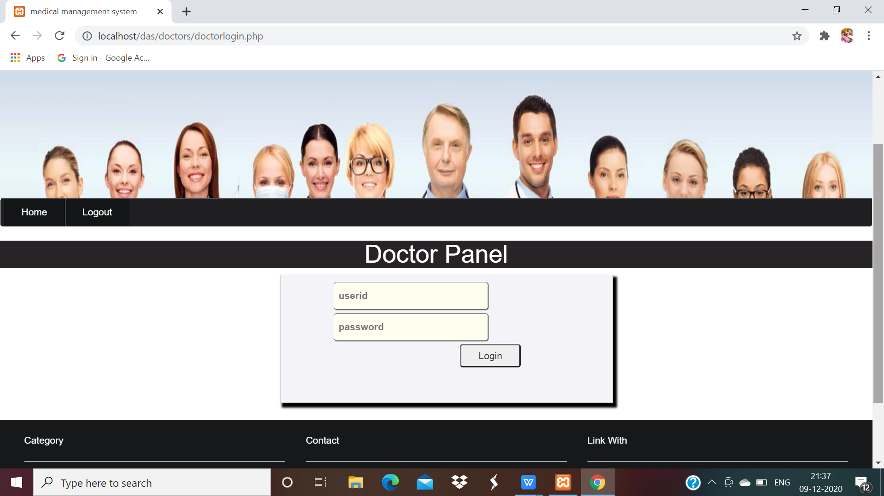
DOCTOR

Slide 24
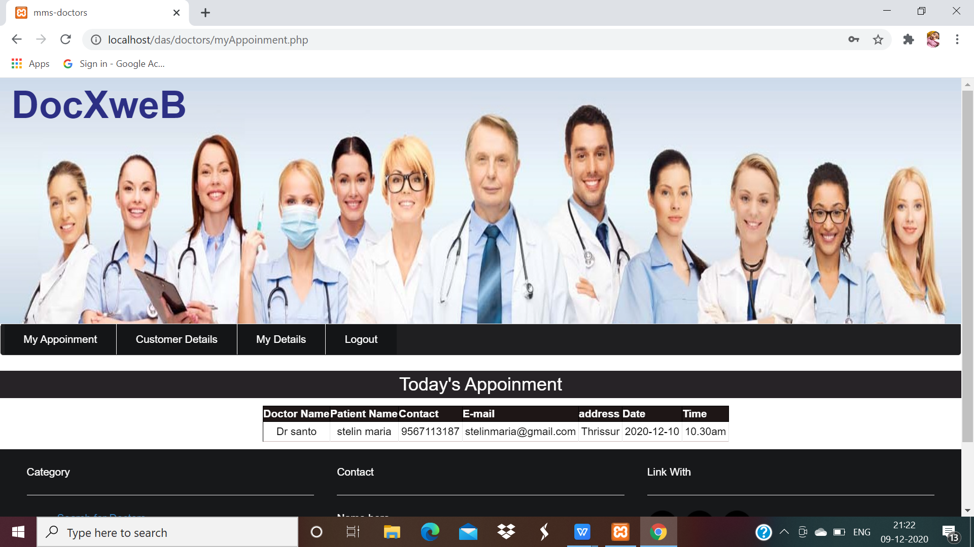

Slide 25
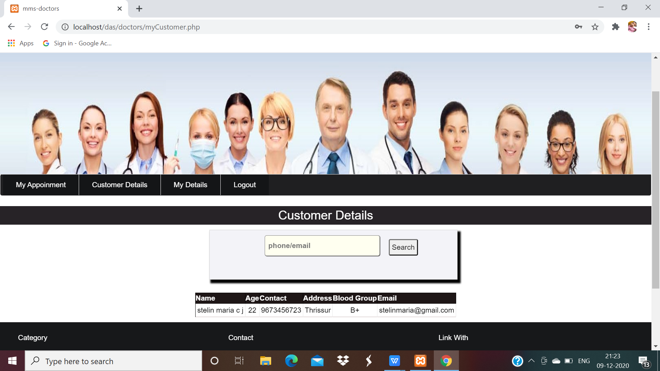

Slide 26
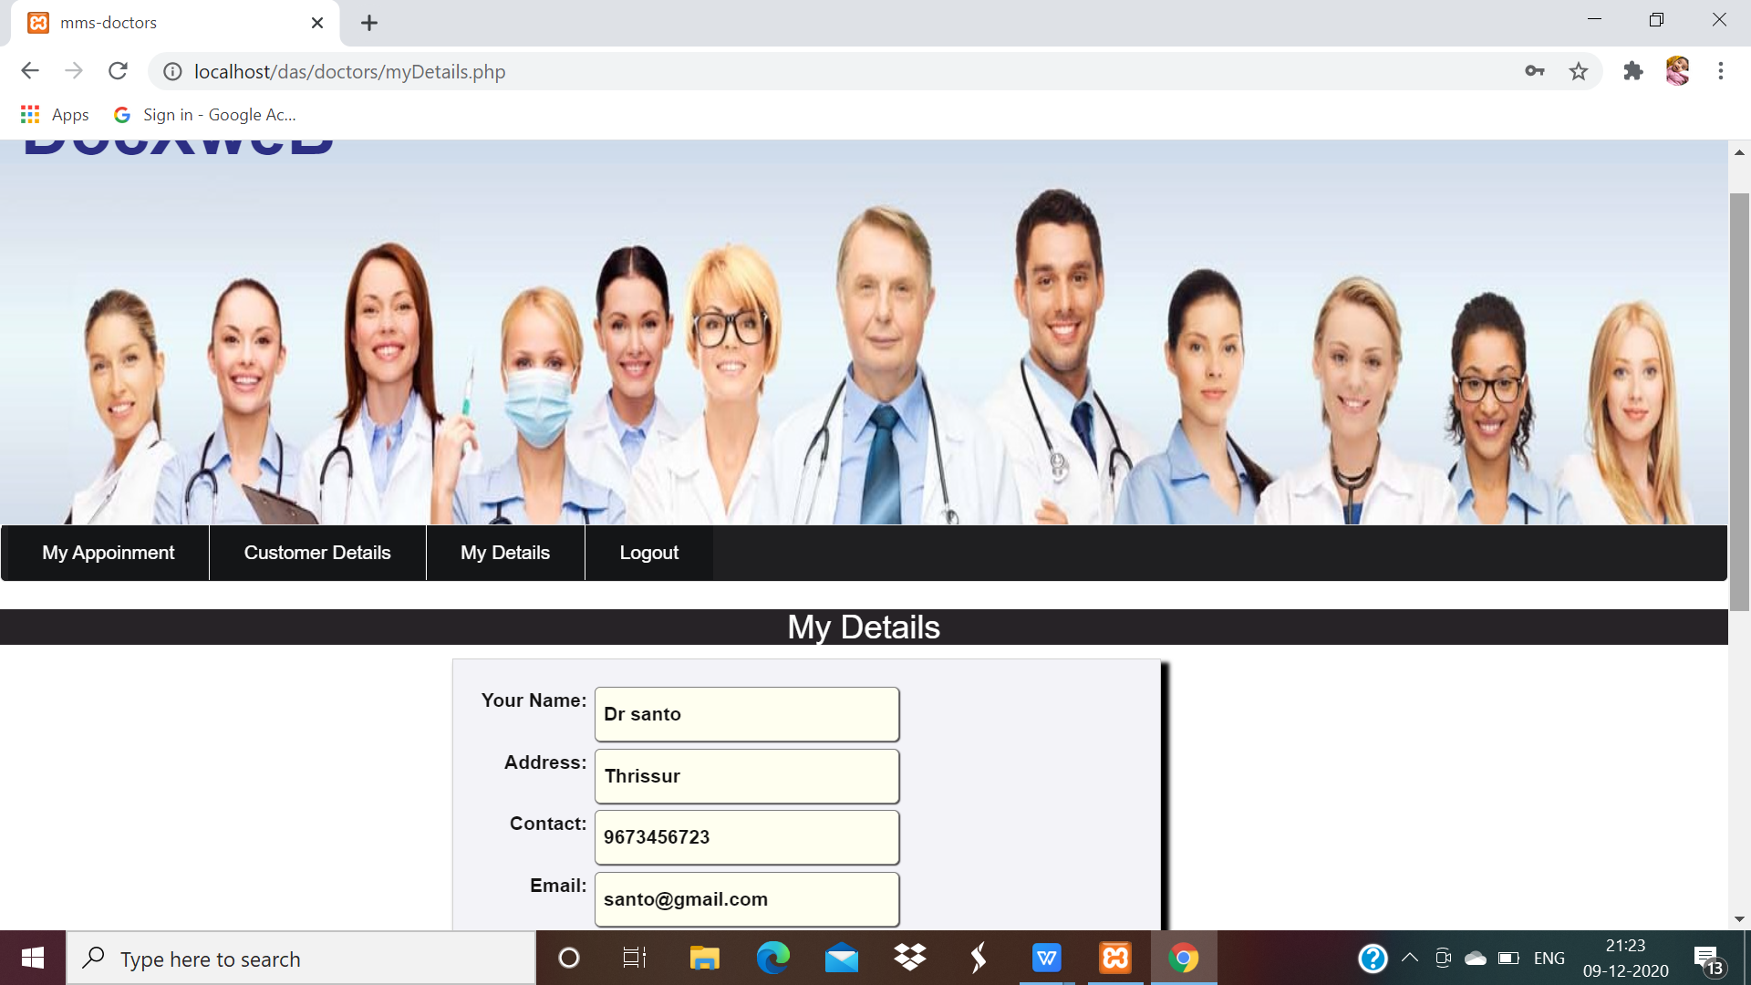

Slide 27
CONCLUSION
This is an user friendly i.e. easy to use. It is free of cost on web platform.
Thus , it is time saving as well as cost efficient application.
However, further improvements are needed for broad use of the system technology.
Working on this project ..........we come to the conclusion that such:
Automation systems are quite beneficial and saving the time of operation.
Thereby increasing the economy of the system in the future, such kind of systems are increasing in demand

Slide 28
THANK YOU

